Slide 1


NIELIT SUMMER INTERN 2021
COURSE:WEB APPLICATION DEVELOPMENT USING APACHE,PHP AND MYSQL
PROJECT TITLE: “SCHOLARO_NEXT”
MADE BY: DRISHTI SHARMA

Slide 2
Tools and skills used :
01
02
03
EDITOR USED:
VISUAL STUDIO CODE
SKILLS USED:
1.HTML
2.CSS
3.JAVASCRIPT
4.PHP
5.MYSQL
ABOUT TITLE:
The title “Scholar_next” is selected to convey the purpose of helping scholars choose the right path for their future.

Slide 3
Features:
Home Page
Login Page
Registration Page
Scholarships Page
Page for English Proficiency Tests
Page for National Entrance Exam
Page for International Entrance Exam

Slide 4
WHAT IS “Scholaro_next”?
Scholaro_next is an educational website that provides information related to a variety of exams ,scholarships whether they are national or international .
The website is mainly created for student group. Keeping in mind, what difficulty a student goes to find right career and self development path, options like e-leaning platforms and scholarships are also embedded in it.
The website fulfils four standards- Useful, Usable, Enjoyable and Equitable.
The vast information related to exams, scholarship makes it useful for the users, the block type structure with easy to understand language makes it usable.
It is equitable as only English language is used . The pictures and design makes it enjoyable.
The internal links used in the website makes the navigation easier.

Slide 5
The website is made dynamic via storing the data of registered user in database.
For that purpose , two pages are separately designed – Login page and Registration page.
For proper guidance , specific topics related to their very purpose are used in the website.
Most of the files are of extension .php with embedded HTML and internal CSS.
In total, this project consists of 7 files (PHP files and HTML files with CSS).

Slide 6
PREVIEW OF WEBSITE VIA SCREENSHOTS

Slide 7
HOME PAGE

Slide 8


Slide 9

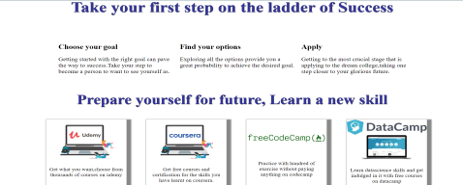


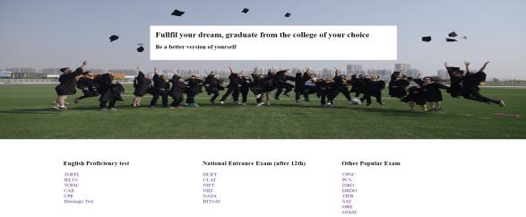

Slide 10

LOGIN PAGE

Slide 11

REGISTRATION PAGE

Slide 12
SCHOLARSHIPS PAGE

Slide 13


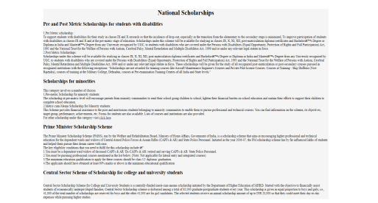

Slide 14



Slide 15
PAGE FOR ENGLISH PROFICIENCY TEST

Slide 16





Slide 17
NATIONAL ENTRANCE EXAM PAGE

Slide 18
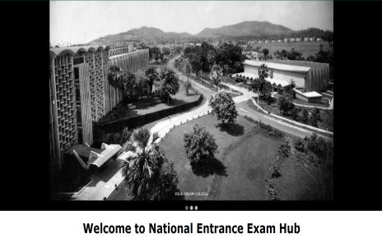
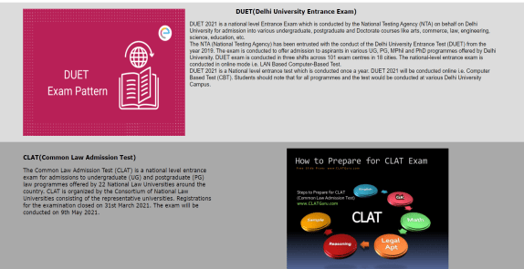
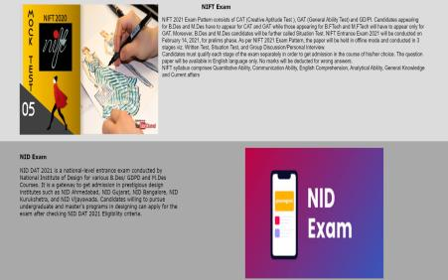


Slide 19
International exam’s page

Slide 20


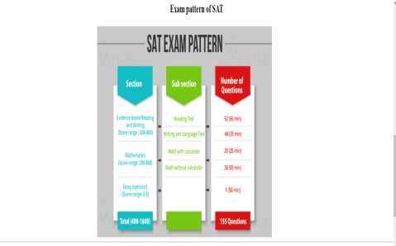
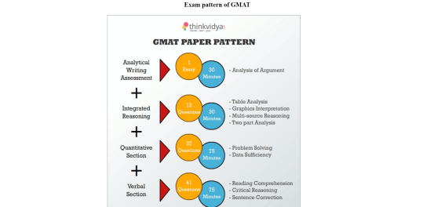

Slide 21
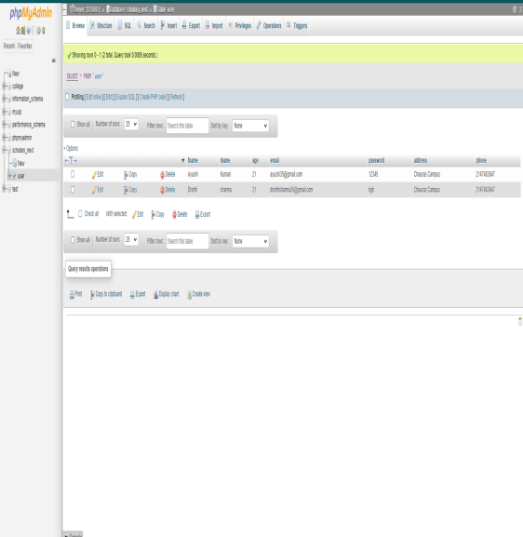
Database info:
A new database is created for this website named Scholaro_next.
A table named User is created inside the database “Scholaro_next” to store the data of the registered user.
The picture shows the stored information of two users.

Slide 22
Files used in making of this website:
new project.php
Scholaro_login.php
Scholaro_register.php
international.php
english_proficiency.php
national.html
scholarship.html
Link to source code: https://drive.google.com/drive/folders/1akNJzZpx62b2rrfnHeSiLo71oLh21GbM?usp=sharing

Slide 23
THANK YOU

